Slide 1
A PROSTATE CANCER DETECTION MODEL USING SUPPORT VECTOR MACHINE APPROACH
BY CHUKWUDI IWUEZE
CLU180203-181
Supervised by:
Prof. S. Folorunso.

Slide 2
Presentation outline
Background to the study.
Problem statement .
Aim and Objectives.
Literature Review
Methodology
Implementation
Conclusion
Future works
Recommendation

Slide 3
Background to the study.
The American cancer Society estimates that in 2021, about 248, 530 men would be diagnosed with Prostate cancer.
With about 34,130 men dying from the disease.
They estimate that 1 in every 8 men 65 years and above would be diagnosed with this disease and that 1 in 41 men would die from the same disease.
In the United States America , the diagnosed cases of prostate cancer was ranked first among malignant tumors. (Bhattacharjee et al, 2019)

Slide 4
Background to the study
Diagnosis of the disease is often very tricky as there are no distinct symptoms with which to diagnose the disease.
However, there are risk factors that are identified in the detection and diagnosis of this disease
Age,
Race
Family history etc.
Diagnosis of prostate cancer is tedious exercise that involve
An oral examination to determine risk factors, like family history, and possible changes in the body of the individual
Following is a PSA blood test.
Then a biopsy, to examine prostate tissue for irregularities.
Collectively, the entire process is meticulous and usually takes time in the delivery of results. However, automation of this process using computational, and analytical techniques makes the process much easier and less time consuming.

Slide 5
Problem statement
Prior to this study, a lot of research has gone into applying machine learning techniques to diagnosing prostate cancer.
Application of a few other model was found to be effective in the classification of data to determine the presence of defined diseases.
This study adds to this wealth of knowledge by applying the support vector machine model in the creation of an Application Programming Interface to diagnose prostate cancer

Slide 6
Aim and Objectives
The study aims to develop a system that could be used as first opinion for people with hugh risk of prostate cancer.
The objectives of the study include
The design of a prostate cancer detection model using support vector machines
The implementation and evaluation of models built to detect prostate cancer
Apply the developed models in an application programming interface.
Review literature on the prediction of prostate cancer using computationally intelligent techniques.

Slide 7
Summary of related works
Author | year | Model | Result
Mukherjee, | 2017 | Neural Networks in image analysis. | The model was found to be more effective than humans in detecting cancer cells. With an accuracy of 72% compared to the 66% of seasoned dermatologists in detecting skin irregularities

Slide 8
Summary of related works
Author | Year | Model | Result
Bhattacharjee et al | 2019 | Used the Support Vector Machine in the analysis of gleason scores for prostate cancer detection. | Their model produced a classification accuracy of 92.5%, 90% 90% 95% for detection of various grades of the gleason score. The model was applied in the development of a detection system. Compared a multi-class classifier like the logistic regression, the accuracy scores were much higher and thus were termed as much more accurate and reliable.

Slide 9
Summary of related works
Authors | Year | Model | Result
Yu et al. “Application of Support vector Machines modeling for porediction of common disease: the case of diabetes and prediabetes” | 2019. | Support Vector Machine | They found that the overall discrimination ability of the classification scheme represented by the AUC values were at 83.27% and 73.18%. Compared to other classification like the multiple logistic regression, there are was no found significant variation. This study proved that classification models are a great tools for medical data analysis for disease diagnosis.

Slide 10
Methodology
This project attempts to develop a detection system using the Support vector Machine as part of an Application Programming Interface
The system uses dataset retrieved from kaggle.com for the analysis and creation of the model.
The model is to be built and trained and tested for accuracy. It is to be compared to other model to ensure that it is optimized accurately to ensure that the best results are obtained.

Slide 11
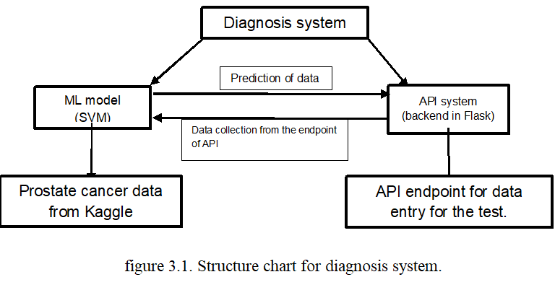
Methodology: structure chart for diagnosis system

Slide 12
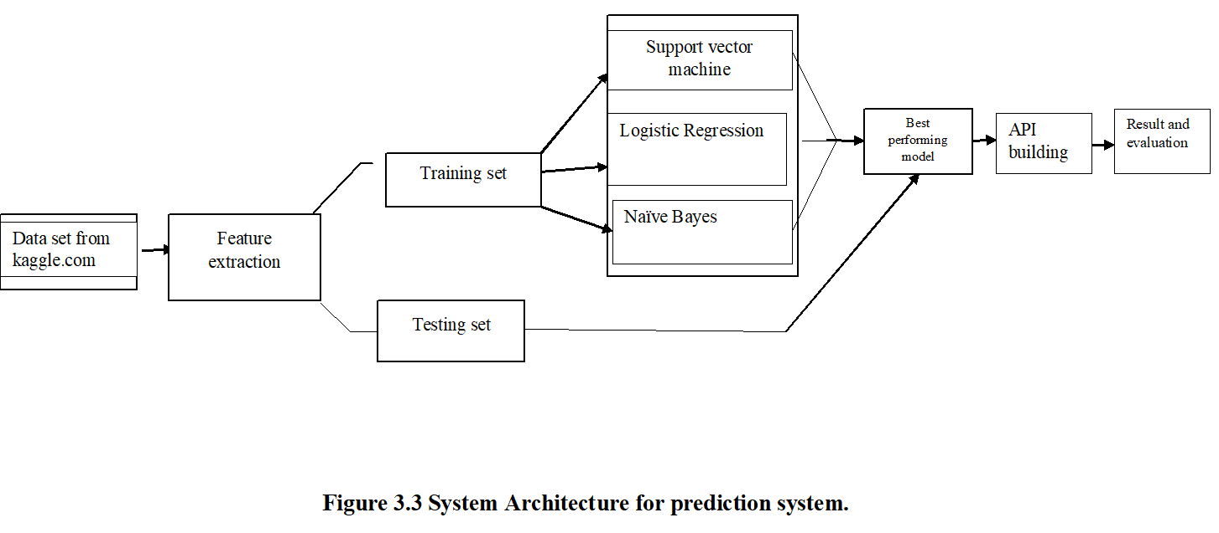
Methodology: system architecture for diagnosis system

Slide 13
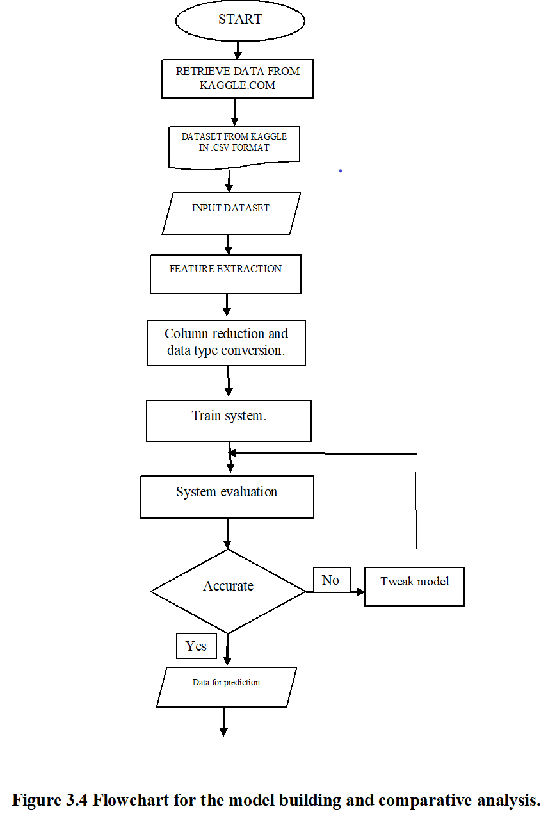
Methodology: Flow chart for model building.

Slide 14
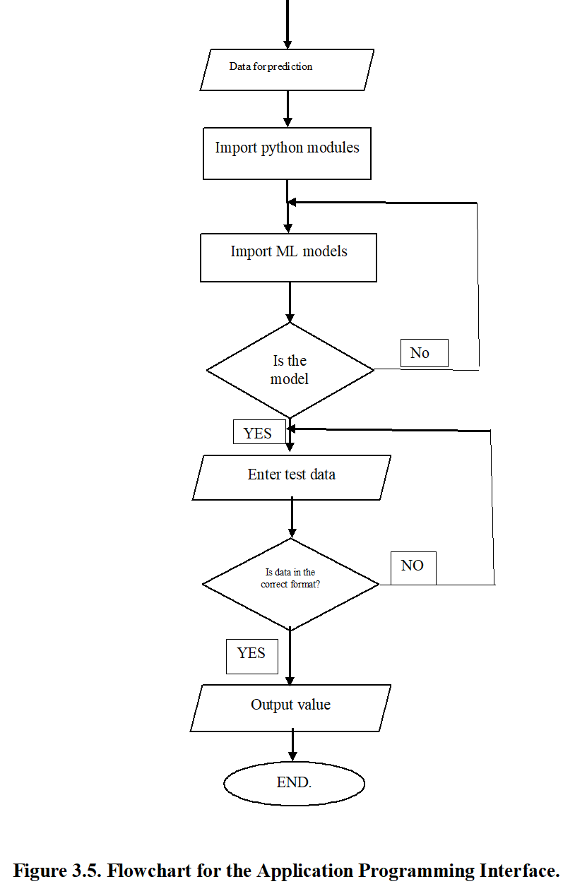
Methodology: flowchart for API building.

Slide 15
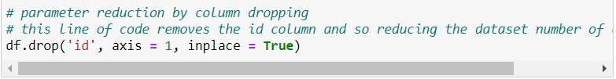
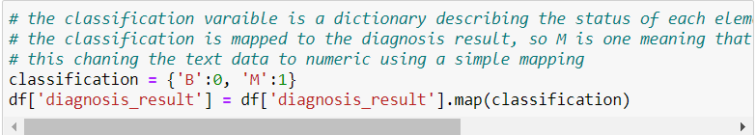
Implementation
The feature extraction phase consists of the reduction of the number of columns used in the data set and the change of datatype of the diagnosis result column.
The code snippet is shown below.

Slide 16
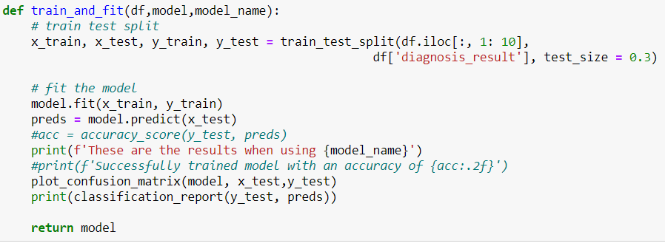
Implementation
Following the feature extraction, the model is trained using the dataset.
The code snippet is shown below.

Slide 17
Implementation
The system is evaluated against other models to determine which model best solves the problem. .
The code snippet is shown below.
 | Accuracy | Macro Average | Weighted Average
SVM | 0.90 | 0.89 | 0.90
Logistic regression | 0.80 | 0.80 | 0.80
Naïve Bayes | 0.83 | 0.82 | 0.83

Slide 18
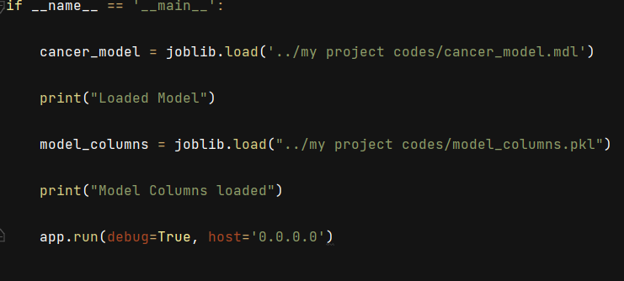
Implementation
After evaluation for accuracy and all the fine tuning of the model and ensuring that the model is perfectly optimized, the model is dumped in a .mdl file, and used in the development of the API.

Slide 19
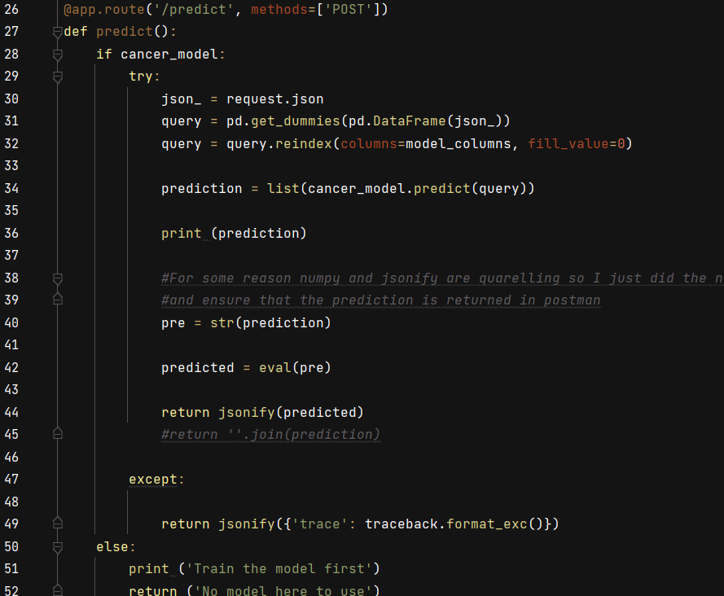
Implementation

Slide 20
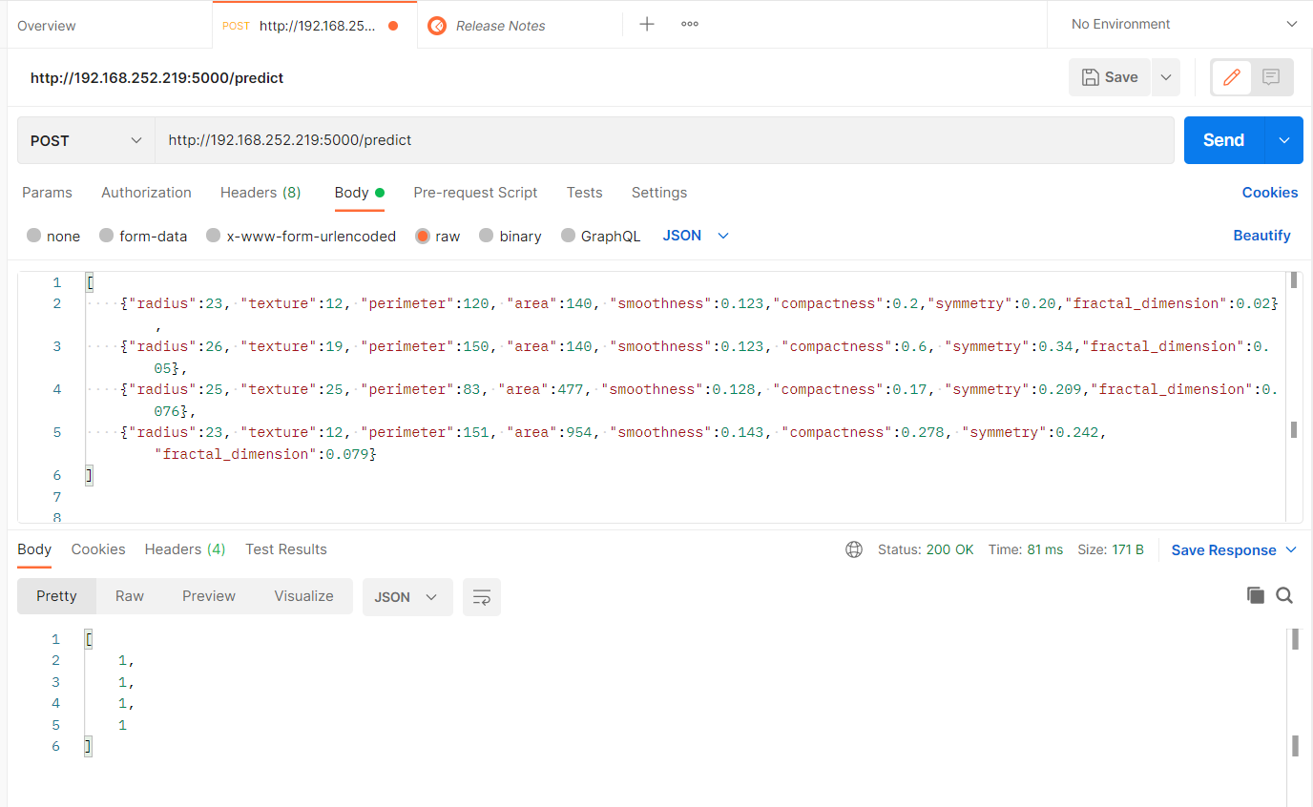
Implementation
The Application Programming Interfaces is tested with postman, calls are posted to the API for evaluation. The result or output is either one representing malignant tumours or zero for benign tumours.
A screenshot of postman is shown below.

Slide 21
Conclusion
In conclusion compared to other models, in the same category the SVM with an estimated accuracy of 90% was found to be the best model for the problem.
This model was used in the development of an API for the diagnosis of prostate using the dataset.
The use of the Support Vector Machine in the API was found to be effective in the diagnosis of prostate cancer.
The high accuracy level of the SVM compared to other model means that the system has a very high chance of correctly identifying the disease.
The API makes the model available for public use.

Slide 22
Future works
The researcher recommends that in the future to make this models available for public use that the API can be used as part of a frontend system that is used by medical practitioners for the analysis and detection of prostate cancer.
The same model can be used to test for other cancers and diagnose the same to help improve the health and lifestyle of individuals who may be prone to this disease.

Slide 23
Recommendation
I recommend that the college pay more attention to courses in numerical analysis and statistics. This should equip her students with the necessary skills to venture more into the more mathematical computation. These skills and knowledge are also very crucial to gaining a career in data analysis and machine learning.
Artificial Intelligence should be taught with a more practical approach. Students should be encouraged to build and test their models. This should afford them more experience in machine learning.

Slide 24
Thank you for listening.

